Slide 1
A Boutique Streaming Platform Bringing Hundreds of Channels to Consumers on over 400 Mobile Devices.

Slide 2
Business Plan
StreamNet is a music and entertainment technology company whose primary business is to provide streaming entertainment content. The company’s goal is to create a conglomerate in many facets, and is preparing to become a major entertainment content provider.
Our plan is to seek to acquire many rights for ownership including:
Music Audio Rights
Movie and Film Libraries
Direct Response TV Advertising
Live Events
Representation of Celebrities Estates
New Releases of Urban & Dance Music Artist
TV Show Rights.

Slide 3
Problems:
The high cost of cable TV combined with bad customer service and the rise of digital and mobile platforms will drive millions to “cut the cord” with their cable providers.
Choice of content options and flexibility of viewing options available at the viewers preferred time and location, the end of fixed programming schedules and bundled unwatched channels.
Watch on their schedule
View on some devices
Live events are expensive
Fan to fan not available
New artists limited access
Long contract

Slide 4
Solution:
OWN THE CONTENT. Has more than 100,000 titles and offers to expand the library substantially in the next two years.
DELIVER HIGHEST QUALITY. Has built a robust scalable platform streaming 4K and 3D resolution video. Virtual Reality coming soon.
FRICTIONLESS MENU. Gives consumers touch and voice activated menu choices for quick search interaction.
OFFER SINGLE VIEW AND MEMBER PRICING. Offers content from as little as $1.00 for a limited view and open access for under $20.
PROVIDE SHARED VIEWING SOCIAL EVENTS. Viewer apps support device to device view casting for friend and family access.

Slide 5
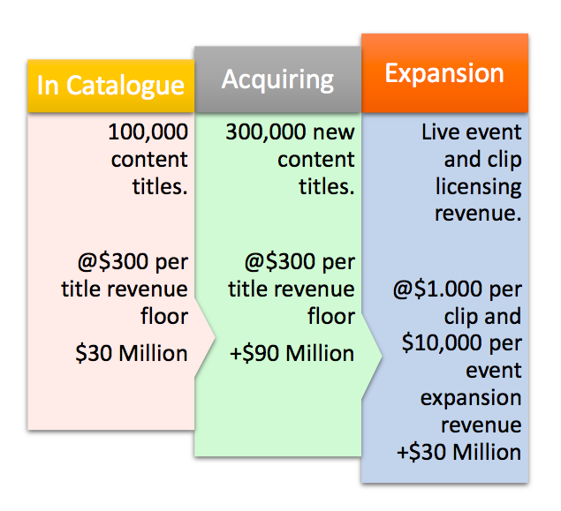
Opportunity
Content increases from value today of +$90 Million towards a valuation of +$300 Million. New artist content potentially offers a doubling effect of valuation as fan adoption increases.
$150 Million Revenue
$300 Million Assets
Acquisition Value of $600 Million

Slide 6
Strategic Plan
Consolidate content and licensing into StreamNet TV
Launch first channel and live test platform
Acquire content to scale above 100,000 titles
Prepare platform to support first 100 channels
Attract new artists
Extend relationships with retail and online partners
Launch entertainment center in Las Vegas.

Slide 7
Leadership
Darryl Payne
President and Chief Executive Officer
Ronnal Cothrine
Vice President of Entertainment Sales
Darryl produced concerts recognized around the globe, building a reputation as Billboard’s number one producer on over 2,000 releases.
Warner Brothers, Sony/BMG, EMI and Virgin have released music produced by Darryl, and he was awarded various Gold Records for productions involving many artists.
Darryl created the Legends of Classic Soul featuring many iconic soul legends including Dennis Edwards Temptations Review, The Whispers, The Four Tops, The Dells, The Dramatics, The Manhattans, The Chi-lites and many more.
Ronnal has a professional career spanning over 30 years of sales and management in the entertainment industry, including over 11 years as District Manager for the Capitol EMI corporation including working on David Bowie and Tina Turner releases to name a few.

Slide 8
Leadership
Don Smalls
Director
Bill Beamon
Vice President of Publishing and Clearances.
With 35 years in the entertainment business producing live events in around the globe, including London, Paris, Glastonbury, New Zealand, Montreux Jazz Festival, etc.
Don has worked with Major Record Labels, Universal Attractions, Live Nation, AEG Live, and the Rock & Roll Hall of Fame.
An extensive industry career that has included working with IMG International, Bill has been directly responsible for managing the royalties departments for many music publishers.
His experience has included working with major brick and mortar and Internet retail accounts. Bill has worked closely with Darryl Payne since 1981 and was directly involved with the production of the Legends of Classic Soul and Classic World Productions.

